Slide 1

Transmission Media

Slide 2

Figure 7.1 Transmission medium and physical layer
7.<number>

Slide 3

Figure 7.2 Classes of transmission media
7.<number>

Slide 4
7-1 GUIDED MEDIA
Guided media, which are those that provide a conduit from one device to another, include twisted-pair cable, coaxial cable, and fiber-optic cable.
Topics discussed in this section:
Twisted-Pair Cable
Coaxial Cable
Fiber-Optic Cable
7.<number>

Slide 5
Twisted pair and coaxial cable use metallic (copper) conductors that accept and transport signals in the form of electrical current.
Optical Fiber is a glass or plastic cable that accepts and transports signals in the form of light
7.<number>

Slide 6
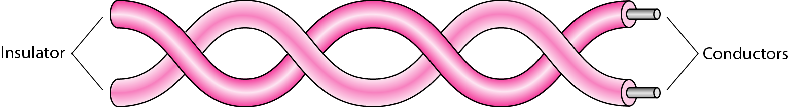
Figure 7.3 Twisted-pair cable
7.<number>

Slide 7
Twisted Pair cable
Twisted pair comes in 2 forms :
Unshielded
Most common type of telecommunication system in use today
Frequency range is suitable for transmitting both data and voice
A twisted pair consists of two conductors (usually copper), each with its own coloured plastic insulation
The plastic insulation is color-banded for identification
7.<number>

Slide 8

Figure 7.4 UTP and STP cables
7.<number>

Slide 9
Advantages of UTP
Cost
Ease of use
Cheap
Flexible
Easy to install
7.<number>

Slide 10
EIA has developed standards to grade UTP cables by quality. Categories are determined by cable quality, with 1 as the lowest and 5 as the highest
Category 1 : basic twisted pair cabling used in telephone systems. Quality is fine for voice but inadequate for all but low speed data communication
Category 2 : Suitable for voice and for data transmission of up to 4mbps
Category 3 : Required to have at least three twists per foot and can be used for data transmission of up to 10 Mbps. It is now the standard cable for most telephone systems.
7.<number>

Slide 11
Category 4 : must also have at least three twists per foot as well as other conditions to bring the possible transmission rate to 16 mbps
Category 5 : used for data transmission up to 100 mbps
7.<number>

Slide 12

Table 7.1 Categories of unshielded twisted-pair cables
7.<number>

Slide 13
Twisted Pair cable
Shielded
It has a metal foil or braided mesh covering that encases each pair of insulated conductors
The metal casing prevents the penetration of electromagnetic noise. It also can eliminate a phenomenon called CROSSTALK (undesired effect of one circuit on another circuit)
It occurs when one line picks up some of the signals travelling down another line
Shielding each pair of a twisted pair cable can eliminate most crosstalk.
7.<number>

Slide 14
STP has the same quality considerations and uses the same connectors as UTP, but the shield must be connected to a ground.
Materials and manufacturing requirements make STP more expensive than UTP but less susceptible to noise.
7.<number>

Slide 15

Figure 7.5 UTP connector
7.<number>

Slide 16
Coaxial cable
Coaxial cable (or coax) carries signals of higher frequency ranges than twisted pair cable
Instead of having 2 wires, coax has a central core conductor of solid or stranded wire enclosed in an insulating sheath, which in turn encased in an outer conductor of metal foil , braid or a combination of the two
The outer metallic wrapping serves both as a shield against noise and as the second conductor which completes the circuit
This outer conductor is also enclosed in an insulating sheath, and the whole cable is protected by a plastic cover
7.<number>

Slide 17

Frequency range is 100 KHz to 500 MHz
Figure 7.7 Coaxial cable
7.<number>

Slide 18

Table 7.2 Categories of coaxial cables
7.<number>

Slide 19
Optical fiber
Is made of glass or plastic and transmit signals in the form of light
These cables consist of one or more thin filaments of glass fiber wrapped in a protective layer.
It transmits light which can travel over long distance and
higher bandwidths. Fiber-optic cables are not affected by
electromagnetic radiation.
Transmission speed could go up to as high as trillions of bits
per second.
The speed of fiber optics is hundreds of times faster than coaxial cables and thousands of times faster than twisted-pair wire.

Slide 20

Figure 7.11 Optical fiber
Fiber Optical : uses reflection to guide light through a channel. A glass or plastic core is surrounded by a cladding of less dense glass or plastic
7.<number>

Slide 21

Figure 7.12 Propagation modes
7.<number>

Slide 22

Figure 7.13 Modes
7.<number>

Slide 23

Table 7.3 Fiber types
7.<number>

Slide 24

Figure 7.15 Fiber-optic cable connectors
7.<number>

Slide 25
Advantages of optical fiber
Noise resistance
Less signal attenuation
Higher bandwidth
7.<number>

Slide 26
Disadvantages of optical fiber
Cost
Installation/Maintenance
Fragility (glass fiber more easily brokem than wire)
7.<number>

Slide 27
7-2 UNGUIDED MEDIA: WIRELESS
Unguided media transport electromagnetic waves without using a physical conductor.
Signals are broadcast through air
This type of communication is often referred to as wireless communication.
Topics discussed in this section:
Radio Waves
Microwaves
Infrared
7.<number>

Slide 28

Figure 7.17 Electromagnetic spectrum for wireless communication
7.<number>

Slide 29

Figure 7.18 Propagation methods
7.<number>

Slide 30

Table 7.4 Bands
7.<number>

Slide 31

Figure 7.19 Wireless transmission waves
7.<number>

Slide 32

Figure 7.20 Omnidirectional antenna
7.<number>

Slide 33

Note
Radio waves are used for multicast communications, such as radio and television, and paging systems.
7.<number>

Slide 34

Figure 7.21 Unidirectional antennas
7.<number>

Slide 35
Note
Microwaves are used for unicast communication such as cellular telephones, satellite networks,
and wireless LANs.
7.<number>

Slide 36
Note
Infrared signals can be used for short-range communication in a closed area using line-of-sight propagation.
7.<number>

Slide 37
Line Configuration
Line configuration refers to the way two or more communication devices attached to a link.
Line configuration is also referred to as connection.
A Link is the physical communication pathway that transfers data from one device to another.
For communication to occur, two devices must be connected in same way to the same link at the same time.
There are two possible line configurations.
1. Point-to-Point.
2. Multipoint.
7.<number>

Slide 38
Point-to-Point
A Point to Point Line Configuration Provide dedicated link between two devices use actual length of wire or cable to connect the two end including microwave & satellite link. E.g. Infrared remote control & TV’s remote control.
The entire capacity of the channel is reserved for transmission between those two devices.
Most point-to-point line configurations use an actual length of wire or cable to connect the two ends, but other options, such as microwave or satellite links, are also possible.
7.<number>

Slide 39
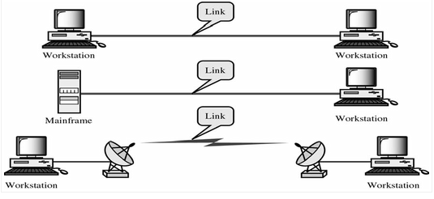
Point to point network topology is considered to be one of the easiest and most conventional network topologies. It is also the simplest to establish and understand. To visualize, one can consider point to point network topology as two phones connected end to end for a two way communication
7.<number>

Slide 40
Multipoint Configuration
Multipoint Configuration also known as Multi drop line configuration one or more than two specific devices share a single link capacity of the channel is shared.
More than two devices share the Link that is the capacity of the channel is shared now.
With shared capacity, there can be two possibilities in a Multipoint Line Config :
  Spatial Sharing
  Temporal (Time) Sharing
7.<number>

Slide 41
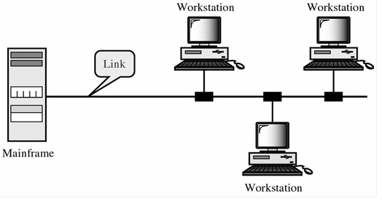
Spatial Sharing: If several devices can share the link simultaneously, its called Spatially shared line configuration
Temporal (Time) Sharing: If users must take turns using the link , then its called Temporally shared or Time Shared Line Configuration
7.<number>

Slide 42
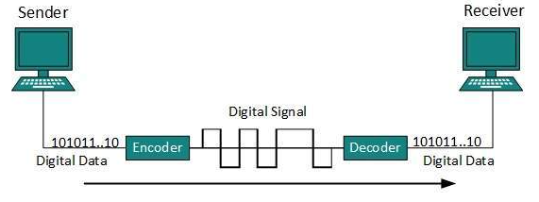
Line Coding
The process for converting digital data into digital signal is said to be Line Coding.
Digital data is found in binary format.
It is represented (stored) internally as series of 1s and 0s.
7.<number>

Slide 43
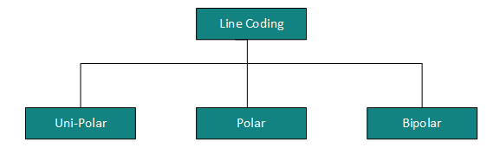
Line Coding contd.
Digital signal is denoted by discreet signal, which represents digital data.
There are three types of line coding schemes available
7.<number>

Slide 44
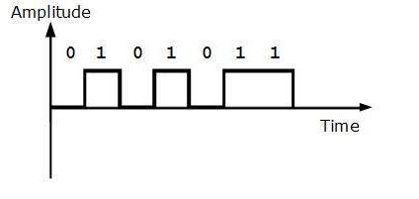
Unipolar Coding
Unipolar encoding schemes use single voltage level to represent data.
In this case, to represent binary 1, high voltage is transmitted and to represent 0, no voltage is transmitted.
It is also called Unipolar-Non-return-to-zero, because there is no rest condition i.e. it either represents 1 or 0.
7.<number>

Slide 45
Polar Encoding
Polar encoding scheme uses multiple voltage levels to represent binary values.
Polar encodings is available in four types:
Polar Non-Return to Zero (Polar NRZ)
It uses two different voltage levels to represent binary values.
Generally, positive voltage represents 1 and negative value represents 0.
It is also NRZ because there is no rest condition.
7.<number>

Slide 46
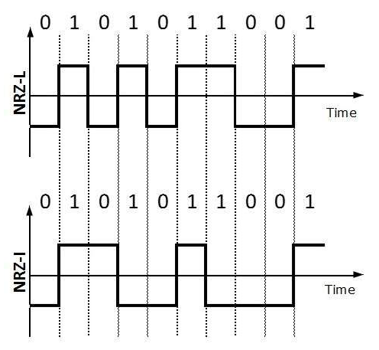
NRZ scheme has two variants: NRZ-L and NRZ-I.
NRZ-L changes voltage level at when a different bit is encountered whereas NRZ-I changes voltage when a 1 is encountered.
7.<number>

Slide 47
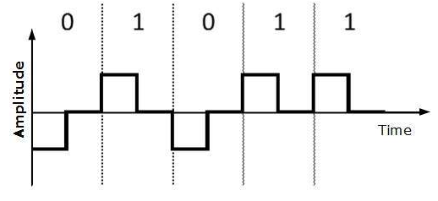
Return to Zero (RZ)
Problem with NRZ is that the receiver cannot conclude when a bit ended and when the next bit is started, in case when sender and receiver’s clock are not synchronized.
RZ uses three voltage levels, positive voltage to represent 1, negative voltage to represent 0 and zero voltage for none. Signals change during bits not between bits.
7.<number>

Slide 48
Polar Encoding contd.
Manchester: This encoding scheme is a combination of RZ and NRZ-L. Bit time is divided into two halves. It transits in the middle of the bit and changes phase when a different bit is encountered.
Differential Manchester: This encoding scheme is a combination of RZ and NRZ-I. It also transit at the middle of the bit but changes phase only when 1 is encountered.
7.<number>

Slide 49
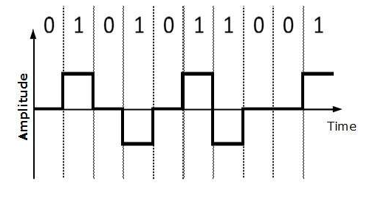
Bipolar Encoding
Bipolar encoding uses three voltage levels, positive, negative and zero.
Zero voltage represents binary 0 and bit 1 is represented by altering positive and negative voltages
7.<number>

